Slide 1
Machine Learning DSECL ZG565
Dr. Monali Mavani
These slides are prepared by the instructor, with grateful acknowledgement of Tom Mitchell, Andrew Ng< Prof. Chetana, Prof. Vimal and many others who made their course materials freely available online.

Slide 2
Topics to be covered
Instance based learning
K-Nearest Neighbour Learning
Locally Weighted Regression (LWR) Learning
Tom Mitchell – Ch 8

Slide 3
k-Nearest Neighbor Classifier
Nearest Neighbour classifier is an instance based classifier
‘lazy learning’, as learning is postponed until a new instance is encountered
Constructs a local approximation to the target function, applicable in the neighbourhood of new instance
Suitable in cases where target function is complex over the entire input space, but easily describable in local approximations
Real world applications found in recommendation systems (amazon).
Caveat is the high cost of classification, which happens at the time of processing rather than before hand (there’s no training phase)

Slide 4
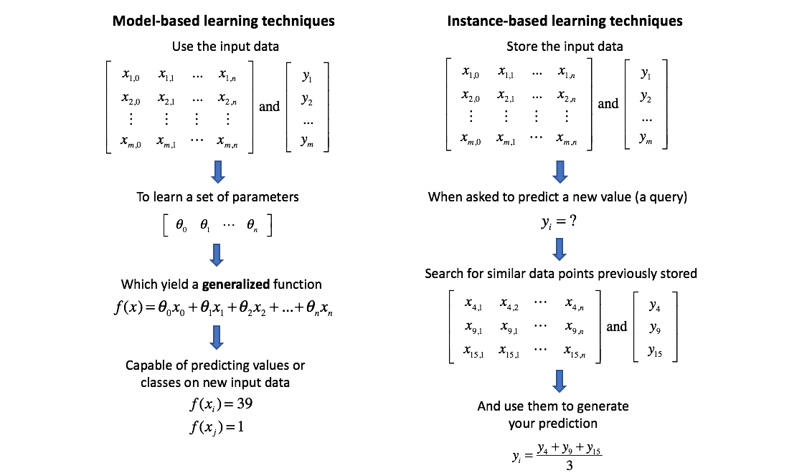
https://www.jeremyjordan.me/k-nearest-neighbors/

Slide 5
Instance Based Learning
Key idea: just store all training examples <x_{i},f(x_{i})>
Nearest neighbor:
Given query instance x_{q}, first locate nearest training example x_{n}, then estimate f*(x_{q})=f(x_{n})
K-nearest neighbor:
Given x_{q}, take vote among its k nearest neighbors (if discrete-valued target function)
Take mean of f values of k nearest neighbors (if real-valued) f*(x_{q})=Σ_{i=1}^{k} f(x_{i})/k

Slide 6
Nearest Neighbor Classifiers
Basic idea:
If it walks like a duck, quacks like a duck, then it’s probably a duck
Compute Distance
Test Record
Training Records
Choose k of the “nearest” records

Slide 7
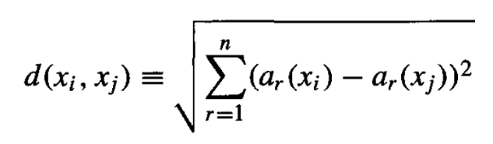
k-Nearest Neighbor Classifier
Considers all instances as members of n-dimensional space
Nearest neighbours of an instance is determined based on Euclidean distance
Distance between two n-dimensional instances x_{i} and x_{j} is given by:
For nearest neighbour classifier, target function can be discrete or continuous

Slide 8
Similarity measure – kernel
A way of measuring how data samples are related or closed to each other.
Used in clustering when similar data samples are grouped into one cluster
Used in classification(e.g. KNN), where the data objects are labeled based on the features’ similarity.
Used in finding dissimilar outliers compared to other data samples(e.g., anomaly detection)
kernel
A number between zero and one, higher value when the data samples are more alike
The dot product represents the similarity between vectors as a single number
Kernels are measures of similarity, i.e. s(a, b) > s(a, c) if objects a and b are considered “more similar” than objects a and c.

Slide 9
Similarity measure –Distance
Distance measures are the fundamental principle for classification, like the k-nearest neighbor’s
Choosing a distance metric would have a strong influence on the performance of the classifier.
Distance metrics are functions d(a, b) such that d(a, b) < d(a, c) if objects a and b are considered “more similar” than objects a and c.
Two objects exactly alike would have a distance of zero.

Slide 10
Distance Measures : Special Cases of Minkowski
h = 1: Manhattan (city block, L₁ norm) distance
h = 2: (L₂ norm) Euclidean distance
h → ∞. “supremum” (L_{max} norm, L∞ norm) distance.
This is the maximum difference between any component (attribute) of the vectors

Slide 11
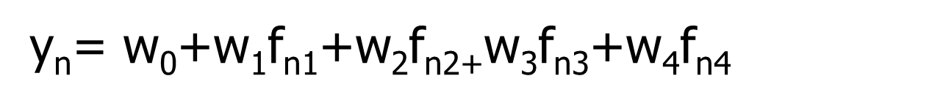
Feature Scaling - Multiple Features
y_{n}= $\text{w}\text{0}\text{+}\text{w}\text{1}\text{f}\text{n}\text{1}\text{+}\text{w}\text{2}\text{f}\text{n}\text{2+}\text{w}\text{3}\text{f}\text{n}\text{3}\text{+}\text{w}\text{4}\text{f}\text{n}\text{4}$
Size (feet²) f1 | Number of bedrooms f2 | Number of floors f3 | Age of home (years) f4 | Price ($1000) y
2104 | 5 | 1 | 45 | 460
1416 | 3 | 2 | 40 | 232
1534 | 3 | 2 | 30 | 315
852 | 2 | 1 | 36 | 178
… | … | … | … | …

Slide 12
Feature scaling - - Standardization
X: raw score to be standardized, μ: mean of the population, σ: standard deviation
the distance between the raw score and the population mean in units of the standard deviation
negative when the raw score is below the mean, “+” when above Where
The Standard Scaler assumes data is normally distributed within each feature and scales them such that the distribution centered around 0, with a standard deviation of 1.

Slide 13
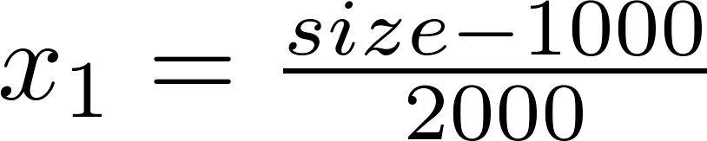
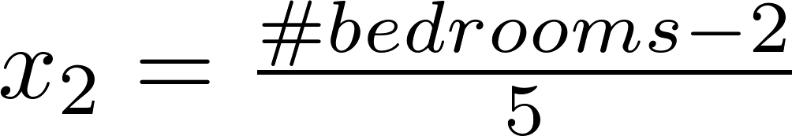
Feature scaling - Normalization
Min-Max scaler/Normalization
Feature scaling of features x_{i} consists of rescaling the range of features to scale the range in [0, 1] or [−1, 1] ( Do not apply to x₀)
Average value of x1
Maximum value of x1 – min value of x1

Slide 14
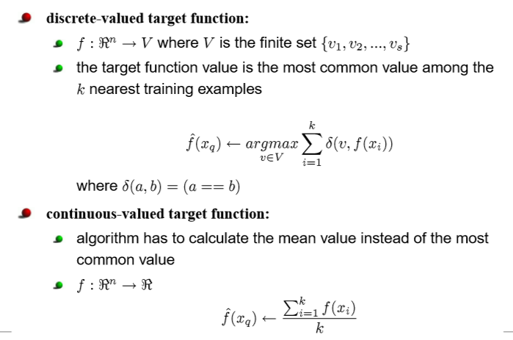
Discrete and Continuous-valued function

Slide 15
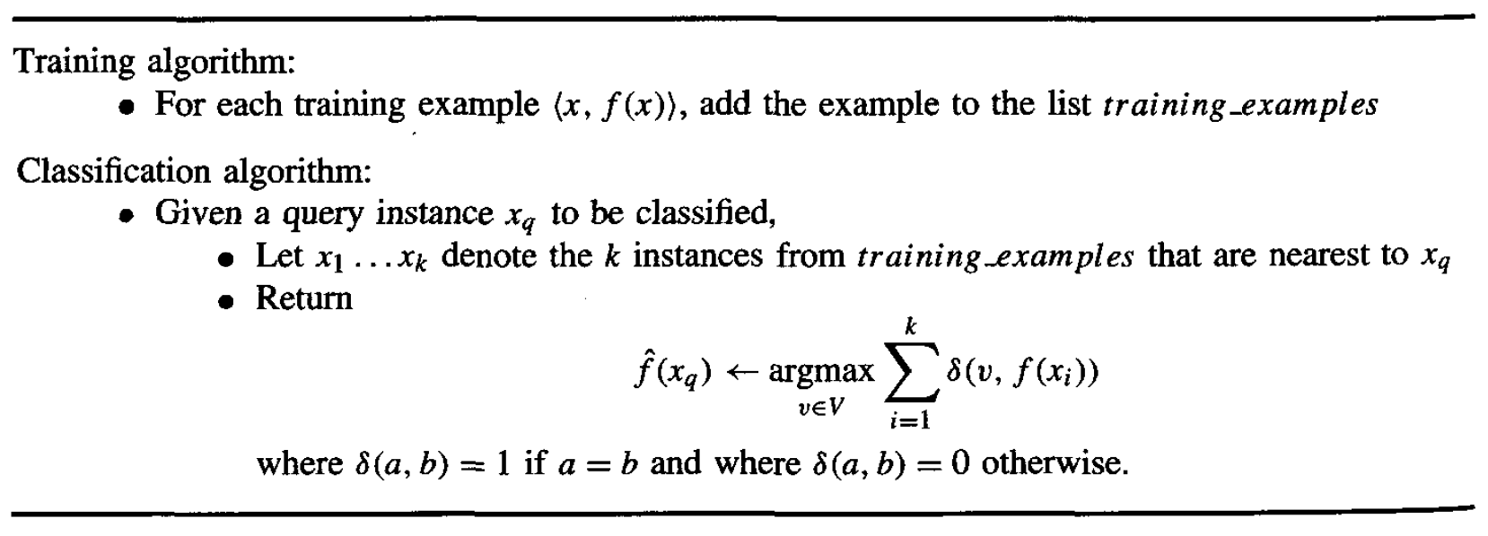
k-Nearest Neighbor Classifier
* It can be used for Regression as well.

Slide 16
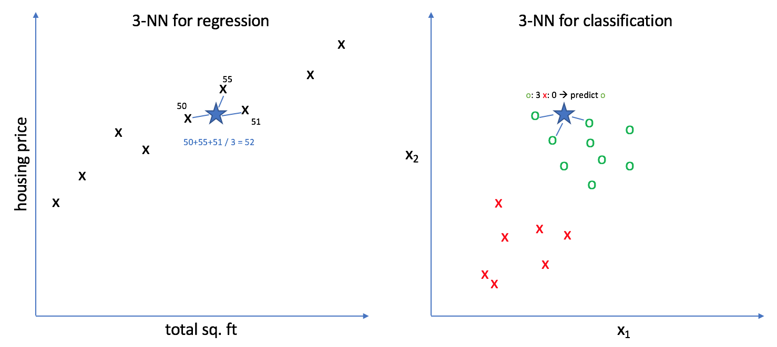
KNN for regression and Classification
https://www.jeremyjordan.me/k-nearest-neighbors/

Slide 17
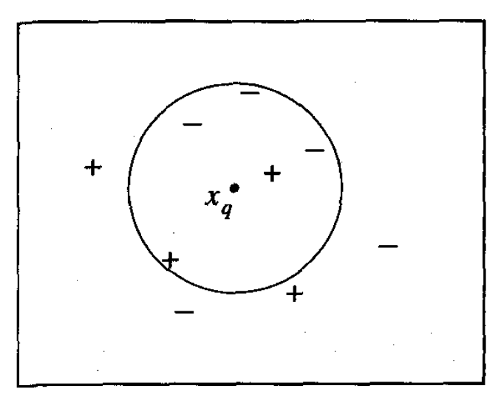
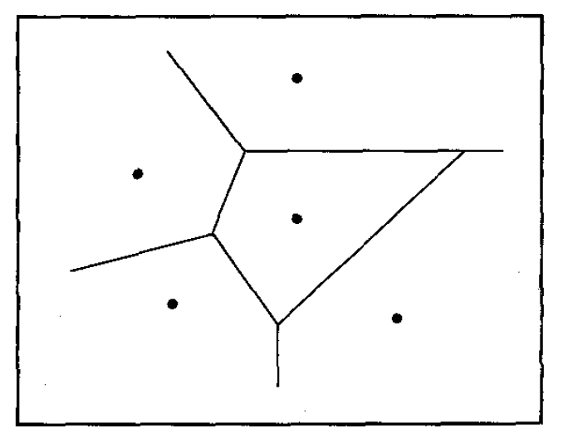
k-NN examples
K=1
K=5

Slide 18
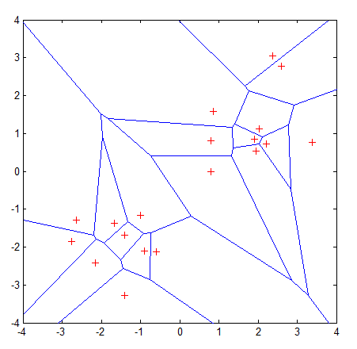
Voronoi Diagram
It is a partition of a plane into regions close to each of a given set of objects.
All possible points within a sample's Voronoi cell are the nearest neighboring points for that sample
For any sample, the nearest sample is determined by the closest Voronoi cell edge

Slide 19
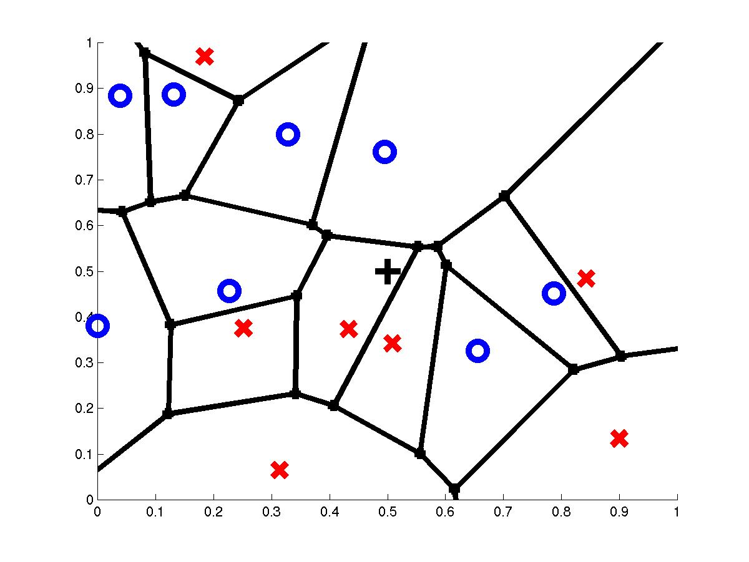
Voronoi Diagram
query point q_{f}
nearest neighbor q_{i}

Slide 20
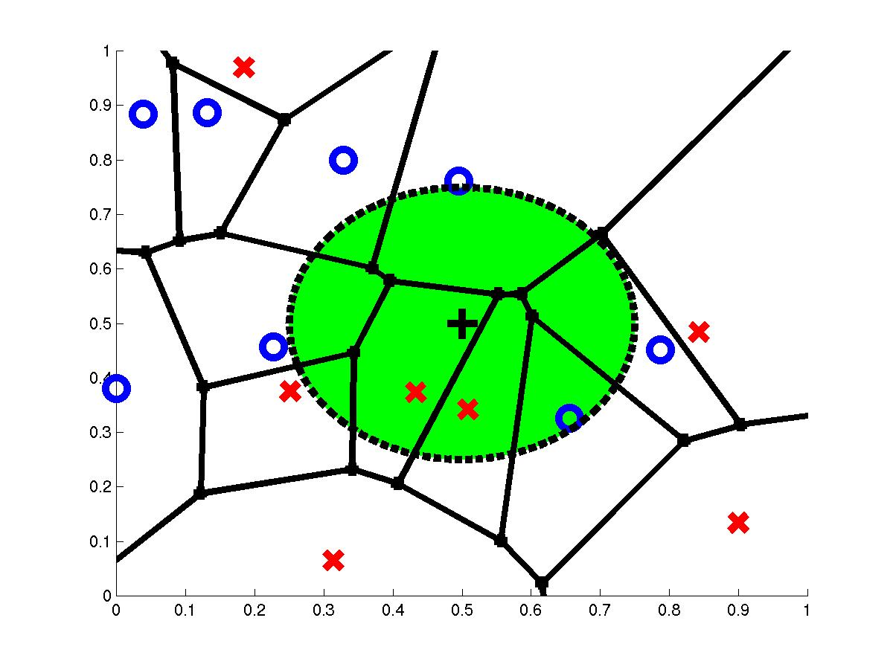
3-Nearest Neighbors
query point q_{f}
3 nearest neighbors
2x,1o

Slide 21
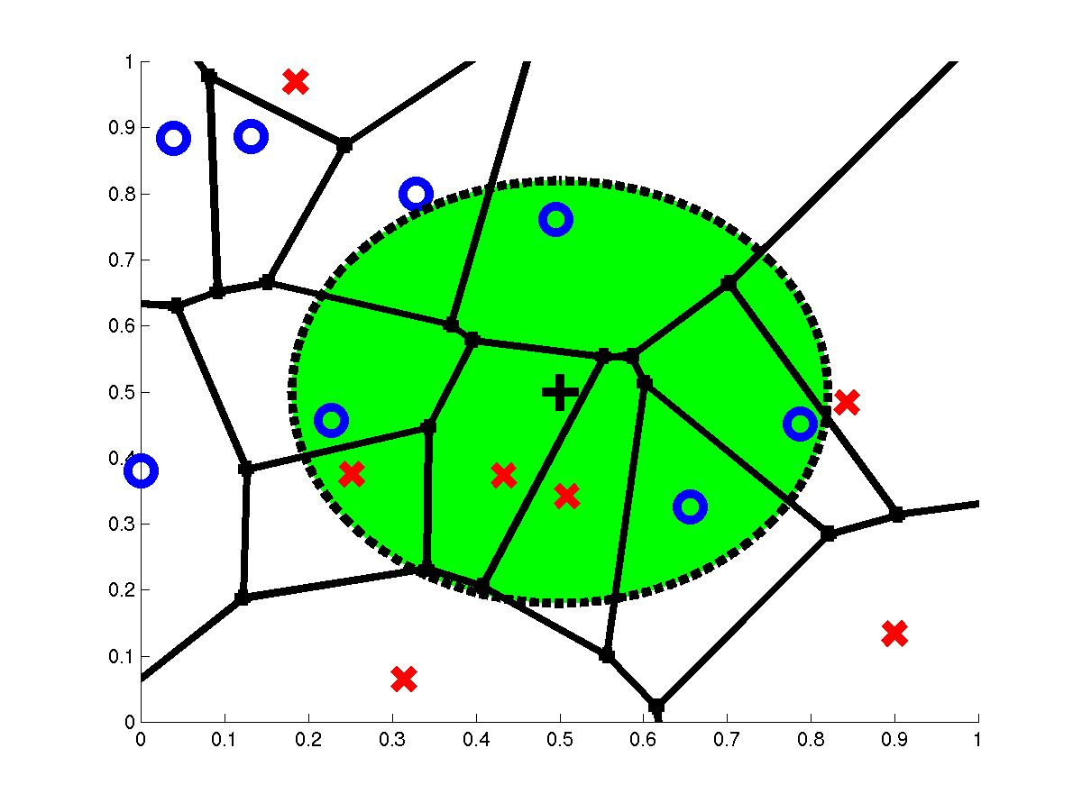
7-Nearest Neighbors
query point q_{f}
7 nearest neighbors
3x,4o

Slide 22
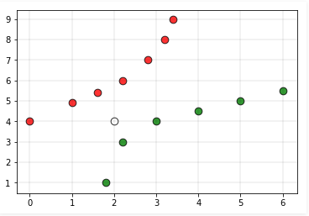
Various issues that affect the performance of kNN:
Performance of a classifier largely depends on the of the hyperparameter k
Choosing smaller values for K, noise can have a higher influence on the result.
Larger values of k are computationally expensive
Assigning the class labels can be tricky. For example, in the below case, for (k=5) the point is closer to ‘green’ classification, but gets classified as ‘red’ due to higher red votes/majority voting to ‘red’

Slide 23
Value of K
Choosing the value of k:
If k is too small, sensitive to noise points
If k is too large, neighborhood may include points from other classes
Rule of thumb:
K = sqrt(N)
N: number of training points

Slide 24
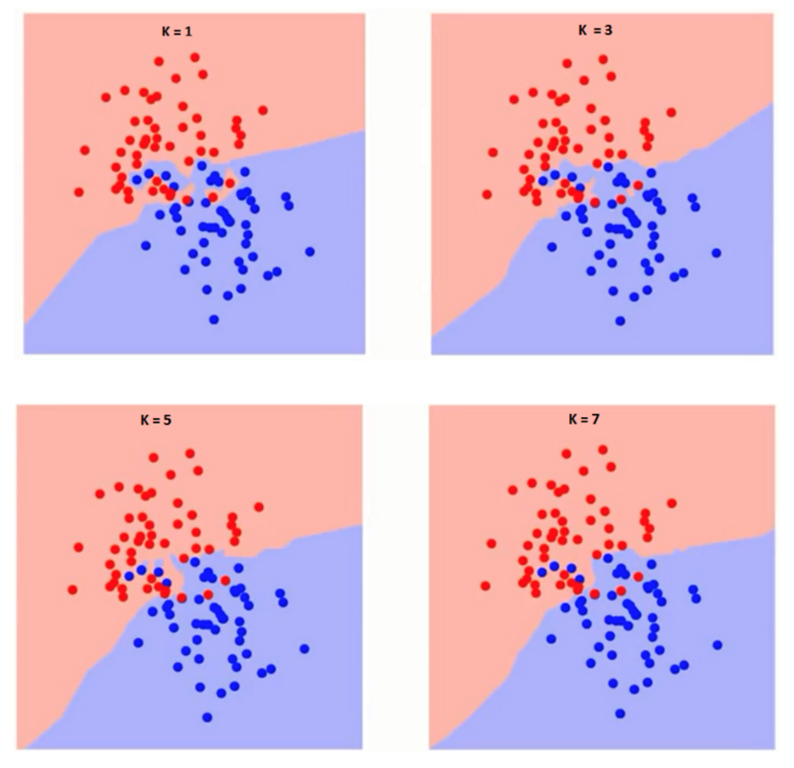
Finding optimal k for kNN classifiers

Slide 25
Finding K - Elbow method
Compute sum of squares error (SSE) or any other error function for varying values of K (1 to a reasonable X) and plot against K
In the plot, the elbow (see pic) gives the value of K beyond which the error function plot almost flattens
As K approaches the total number of instances in the set, error function drops down to ‘0’, but beyond optimal K, the model becomes too generic
Error function (SSE)
K value

Slide 26
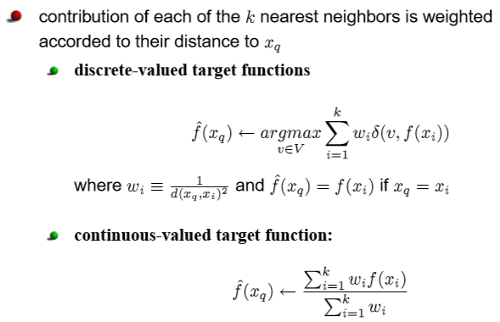
Distance weighted nearest neighbor

Slide 27
Distance Weighted k-NN
Give more weight to neighbors closer to the query point
w_{i}=K(d(x_{q},x_{i}))
K(d(x_{q},x_{i})) = 1/ d(x_{q},x_{i})²
K(d(x_{q},x_{i})) = 1/(d₀+d(x_{q},x_{i}))²
K(d(x_{q},x_{i})) = exp(-(d(x_{q},x_{i})/σ₀)²)
d(x_{q},x_{i}) is the distance between x_{q} and x_{i}
Variation: Instead of only k-nearest neighbors use all training examples (Shepard’s method)

Slide 28
Distance Weighted Average
Weighting the error criterion
E(x_{q}) = Σ_{i} (f*(x_{q})-f(x_{i}))² K(d(x_{i},x_{q}))
Best estimate f*(x_{q}) will minimize the cost E(x_{q}), therefore ∂E(x_{q})/∂f*(x_{q})=0

Slide 29
Curse of Dimensionality
Imagine instances described by 20 attributes but only a few are relevant to target function
Curse of dimensionality: nearest neighbor is easily misled when instance space is high-dimensional
First approach:
completely eliminate the least relevant attributes from the instance space. This is equivalent to setting some of the z_{i} scaling factors to zero
Use of cross-validation methods for selecting relevant subsets of the attributes

Slide 30
Second approach
weight each attribute differently when calculating the distance between two instances i.e
stretching the axes in the Euclidean space, shortening the axes that correspond to less relevant attributes, and lengthening the axes that correspond to more relevant attributes.
The amount by which each axis should be stretched can be determined automatically using a cross-validation approach
To stretch (multiply) the jth axis by some factor z_{j}, where the values z₁ . . . z_{n}, are chosen to minimize the true classification error of the learning algorithm

Slide 31
When to Consider Nearest Neighbors
Instances map to points in R^{N}
Less than 20 attributes per instance
Lots of training data
Advantages:
Training is very fast
Learn complex target functions
Do not lose information
Noisy training data

Slide 32
Nearest Neighbours issues
Expensive, Slow at query time
To determine the nearest neighbour of a query point q, must compute the distance to all N training examples
Pre-sort training examples into fast data structures (kd-trees)
Compute only an approximate distance (LSH)
Remove redundant data (condensing)
Storage Requirements
Must store all training data P
Remove redundant data (condensing)
Pre-sorting often increases the storage requirements
High Dimensional Data
“Curse of Dimensionality”
Required amount of training data increases exponentially with dimension
Computational cost also increases dramatically
The inductive bias : an assumption that the classification of an instance x_{q}, will be most similar to the classification of other instances that are nearby in Euclidean distance

Slide 33
Locally Weighted Regression

Slide 34
Locally Weighted Regression
Locally – Function approximated based on data near query point
Weighted – Contribution by each training example is weighted by its distance from query point
Regression- Approximates real-valued target function

Slide 35
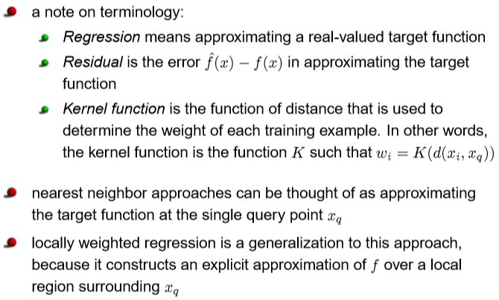
Locally weighted regression

Slide 36
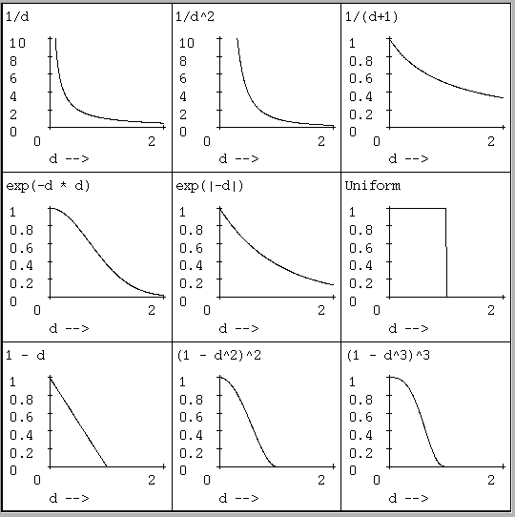

Slide 37
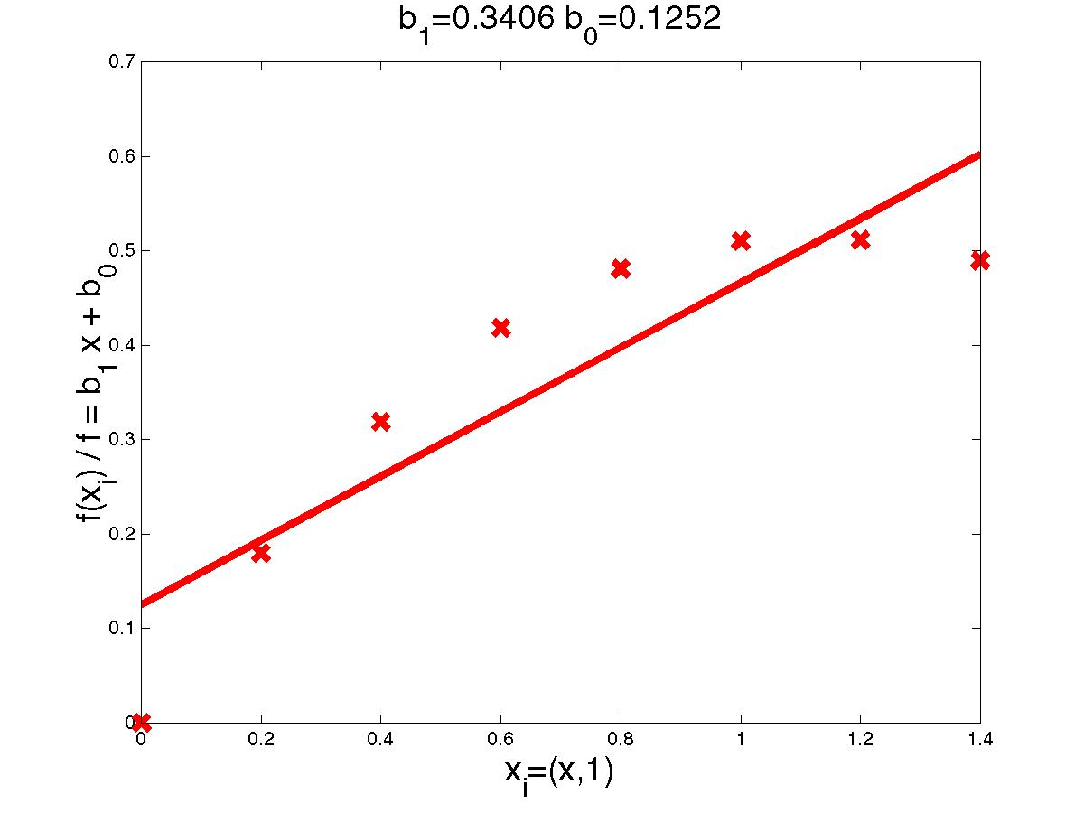
Linear Regression Example

Slide 38
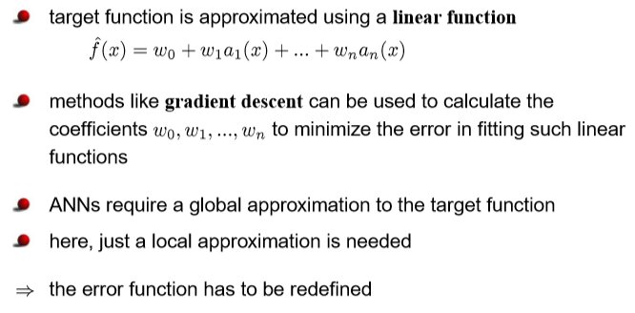
Locally weighted regression

Slide 39
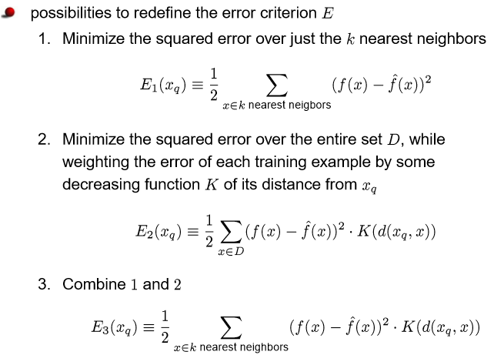
Locally weighted regression

Slide 40
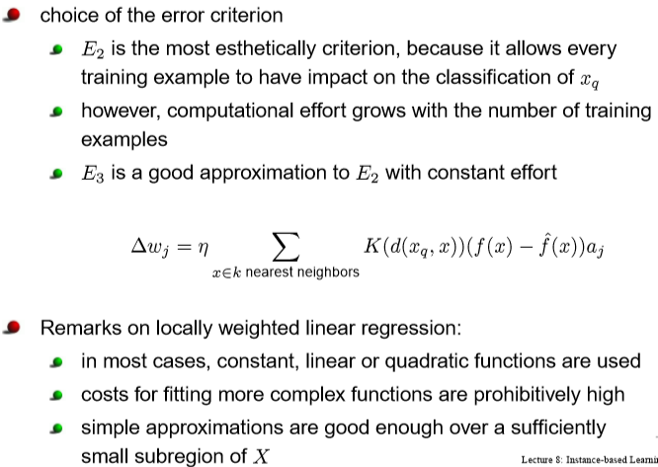
Locally weighted regression

Slide 41
Lazy and Eager Learning
Lazy: wait for query before generalizing
k-nearest neighbors, weighted linear regression
Eager: generalize before seeing query
Radial basis function networks, decision trees, back-propagation
Eager learner must create global approximation
Lazy learner can create local approximations
If they use the same hypothesis space, lazy can represent more complex functions (H=linear functions)

Slide 42
Thank You
20 February 2022

